Slide 1

Digital Analytics

Slide 2
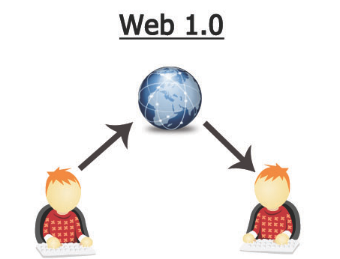
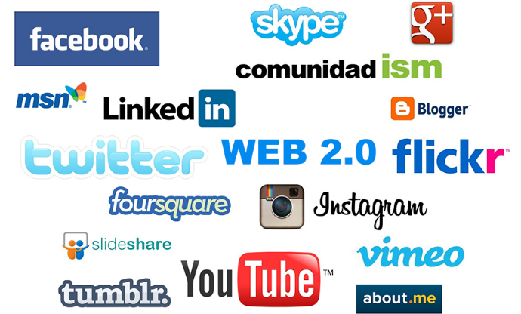
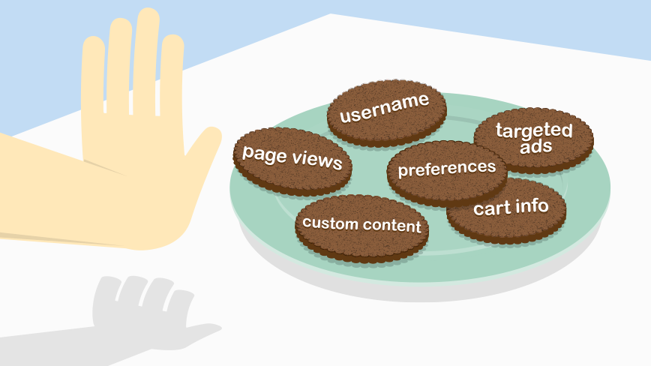
The Birth of Digital Marketing
The digital age as we now know it began with the Internet and the Web 1.0 platforms of the early 1990s. This was a rather static world in which users could get the information they desired but it could not be shared on the web. There was no such thing as interaction, as the only activity was reading of content.
Then came Web 2.0, where people became more active participants rather than remain passive users. Web 2.0 allowed users to interact with other users and businesses. The development of Web 2.0 changed the way people used the internet, which caused marketers to change how they market—it became less about overtly advertising to someone and became more about creating an experience people wanted to be a part of.
The cookie was another important milestone in the digital marketing industry. Advertisers had begun to look for other ways to capitalize on the fledgling technology. One such technique was to track common browsing habits and usage patterns of frequent users of the internet so as to tailor promotions and marketing collateral to their tastes

Slide 3
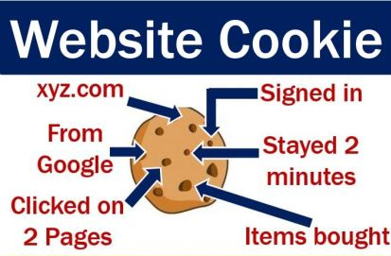
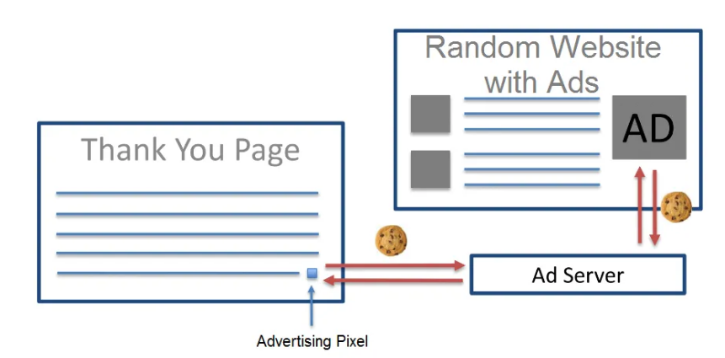
Cookies, Pixels and DMPs – What goes on behind the scenes (1 of 2)
Cookies aren’t programs, they are small text files that are placed on a visitor’s machine through websites they browse.
For instance, a lot of sites use cookies to save ID and passwords. Others use them to refill the checkout cart when the visitor returns. These are primarily first-party cookies.
Services like DoubleClick, LiveRamp, etc. place a 3rd party cookie that they use to track user activity across the web space. An important thing to note here is that you can only read those cookies that you have placed, because all cookies have unique properties. For example, Amazon cannot read a cookie that Wells Fargo has placed in a visitor’s browser.
Pixels are different tools used to get a better understanding of the users on your website. They are used to help identify, collect, and transfer data from a given site to software catering to analytics and advertising services.
Pixels (tags) are typically an invisible single pixel. These pixels fire, or a JAVA code executes (both mean the same thing), when the webpage is loaded and capture important information about the visitor. Pixels can also place a new cookie in a visitor’s browser or check if there is an existing cookie already there.

Slide 4
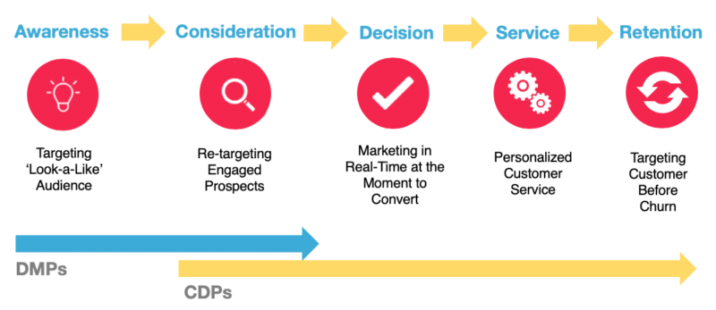
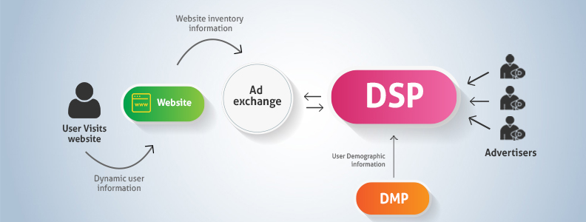
Cookies, Pixels and DMPs – What goes on behind the scenes (2 of 2)
Data Management Platform
A data management platform (DMP) is a platform to collect, organize and activate first-, second- and third-party audience data from any source, including online, offline, mobile, and beyond.
Data storage is the key-word.
Customer Data Platform
It a system that ingests, consolidates and normalizes customer data from multiple online and offline sources, regardless of the data's structure or identifier (email, cookie, etc). The data is centralized, wrangled and enriched so other systems (usually 3rd party tools) can understand and utilize them for custom analytics, marketing campaigns, and other data-related business needs.
Demand-Side Platform (DSP)
A demand-side platform (DSP) is a system for advertisers to purchase and manage ad inventories from multiple ad sources through a single interface. This is normally done using intelligent software which bids on the inventories using an auction process. This makes the buying and selling of ads cheaper and more reliable.
This whole setup is termed as “programmatic advertising” and the bidding process by which ad placements are auctioned within micro-seconds is called “real-time bidding (RTB)”.

Slide 5
Digital Marketing Jargon buster
Banner Ad
form of advert found on web pages and mobile applications, usually in image format.
Click Through
Rate
The number of times people click on an item of interest, like an
advert, in comparison to the number of times users are exposed to that item.
Cost per Click
The amount of money required to produce a single click on a digital
advertisement.
Crawler or Spider
A program designed to systematically browse content on the Internet and collect information about it to help searchers find what they’re looking for.
Impressions
Landing Page
The number of times an advert is displayed.
The first page on a website that a person usually sees—not necessarily the home page of that website.
Organic Listing
PayPerClick
(PPC)
Advertising system in which advertisers pay for users to click on their
advertisements.
SEO
The practice of making changes to web pages, content, and the promotion of that content to improve visibility in the organic search engine results.
Results from a search engine that are not paid adverts.
Bounce
Percentage of visitors who enter the site and then leave rather than continuing to view other pages within the same site.
Session or Visit
A group of interactions that take place on your website within a given time
frame.
Traffic Acquisition
The process of attracting visitors often referred to as traffic to websites, mobile apps and other digital assets.

Slide 6
Data Science for Digital Marketing
Adobe Marketing Cloud Platform

Slide 7
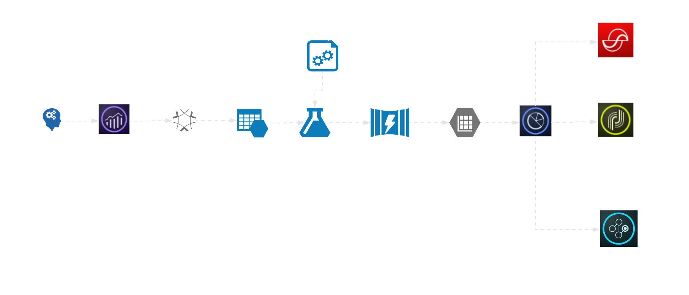
Sample Workflow
Sample workflow

Slide 8

Attribution Analysis Quantify marketing impact of each individual marketing touchpoint across customer journeys at every level of granularity
ACTIVE TOUCHPOINTS
Paid Search Click
Branded Keyword
$20
Free sign up
$50
Paid Search Click Branded Keyword
$50
Email Sent
$25
Email Click
$25
$500
PURCHASE
Display Impression
$30
Email Sent
$30
Email Open
$20
$250
Incremental Impact
PASSIVE TOUCHPOINTS

Slide 9







Customer Analytics Hyper-personalize customer experiences intelligently
4x
propensity scores generated in real time
more valuable audience segment identified
Private Preview Customer
BENEFITS
Deliver advanced insights across defined outcomes to enable stronger audience segmentation and targeting
Enable segment-based behavioral modeling to understand the rationale and likelihood of a user taking a specific action
Simple configuration mechanism to customize for each company’s unique use cases and data assets
Customer ID. =
2415
Address =
123 Main Street
Detroit, MI USA
1
Churn propensity = 40%
Reasons for churn propensity =
Low usage
2
Reasons for upsell propensity for premium bundle = Current SKU, purchase date
3
A upsell propensity
for premium bundle = 10%
Sarah Rose

Slide 10


Social Commerce
Messenger-based Social Commerce is an innovative conversational commerce capability of Adobe Commerce Cloud that allows brands to provide a seamless and convenient shopping experience to customers within their preferred messenger app.
AI-powered chatbot
Personalized product recommendations
1:1 conversational experience
Seamless payment
Abandoned cart recovery from web/mobile app

Slide 11






Overview
Related products
Run Long Run Light
RUN
Real-time profile enrichment
In-video object recognition
Smart Dimensions is an innovative solution that enables marketers to target its audience with real-time contextual advertising without interrupting their online video viewing experience.
BUY NOW
ADD TO CART
THE ULTIMATE RUN
Integrated shopping cart experience
SPECIAL EDITION
BUY NOW
ADD TO CART
Contextual targeting

Slide 12
Analytics use cases – Insights using clickstream

Slide 13


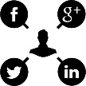







Covid -19 Impact assessment
Understand how the pandemic is reshaping consumer behaviour: Explore evolving trends, patterns, preferences and the paradigm shift in consumer behaviour to realign marketing strategy, campaigns, content and consumer targeting
Output
Website Analysis
Visitors Profiling
Campaign Analysis
Objective
What pages, categories and type of content perform best pre and during Covid-19 period?
What is the profile and key characteristics of consumers visiting brand.com during the Covid-19 period and how do they compare to pre Covid-19 web visitors?
What additional insights can we get from digital assets and campaigns produced during COVID-19 period?
Audience creation
Study was done basis Unique Visitors, Average time spent and Bounce rate
Index was calculated to understand popular content and shift in interest
\
Create Audience
Enrich
Validate
Compare
Recommendations
Approach
Calculate overlap% between website visitors(1st party) and 3rd party
indexing to understand how important each characteristic is
Profiled this audience to understand their key characteristics, and compared pre and during COVID-19
Built the required audience using multiple data sources
Derive Insights and recommendations for follow up/next steps and embed this into future campaigns
Revamp popular pages
Design new content for Brand.com page
Design campaigns
Decide New target Audience
Design Content according to new preferences of consumer
Optimize media channels
Budget media spend
Impact

Slide 14
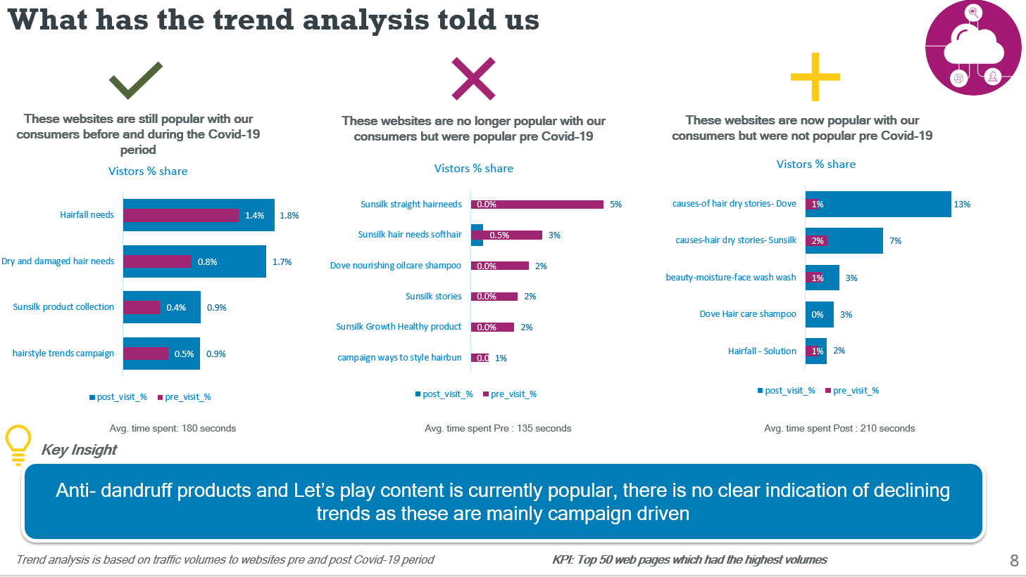

Slide 15
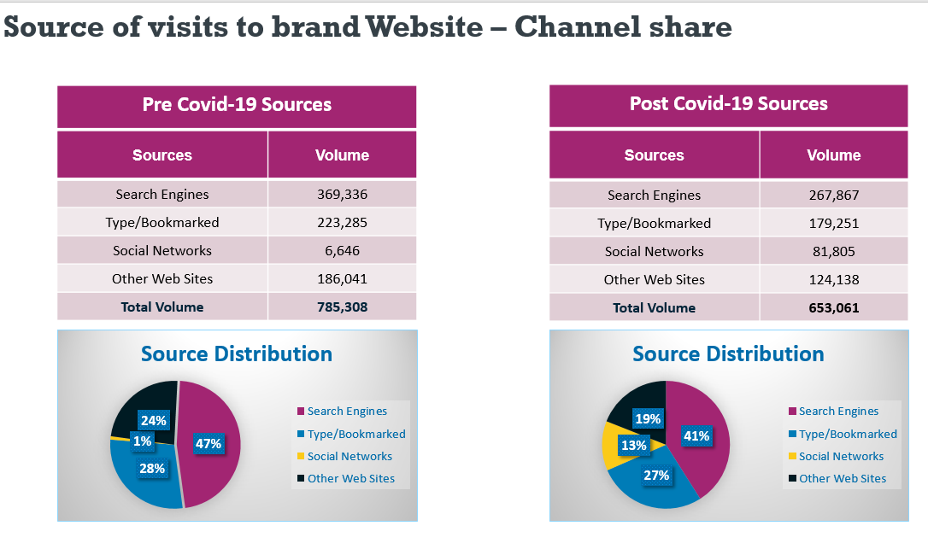

Slide 16
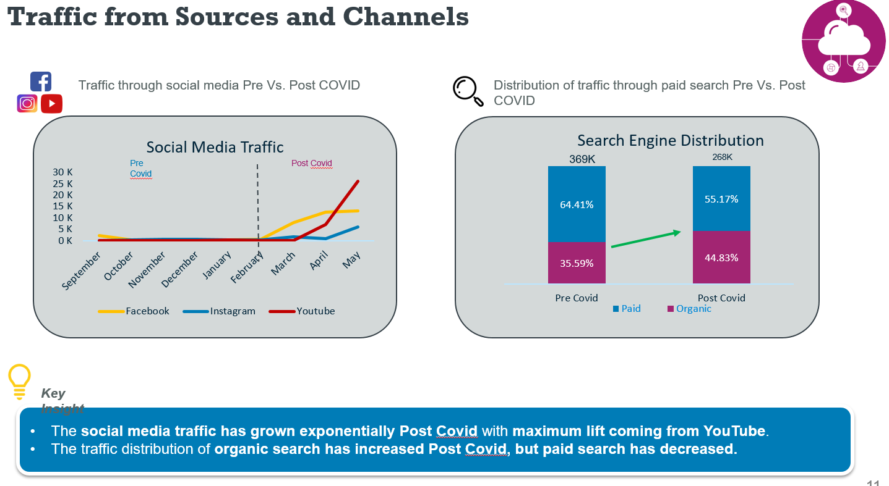

Slide 17
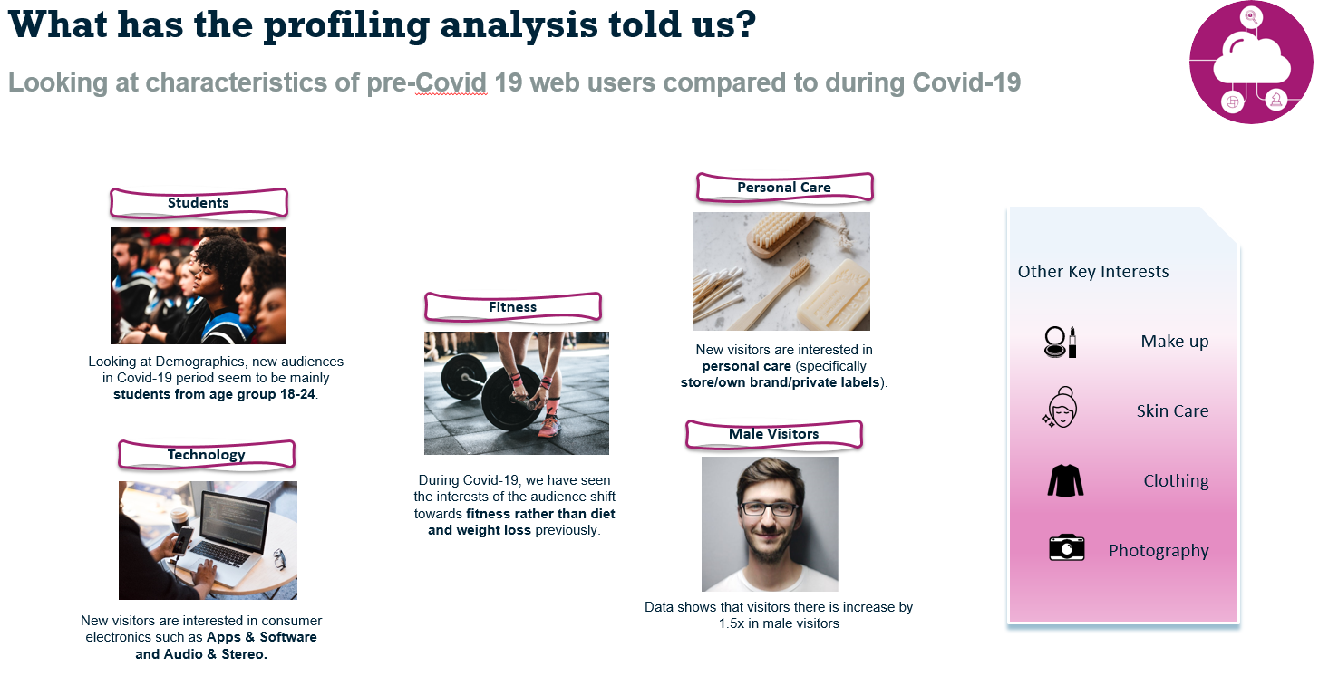
Back

